Slide 1
7.4 Inverse Trig Functions
Who uses this?
Actuaries
Aerospace Engineers
Mechanical Engineers
Nuclear Engineers
Economist
Boilermakers

Slide 2
Inverse Sine Function
For a function to have an inverse it must be one-to-one.
One-to-one functions have to pass the horizontal line test. Each y-value can be paired with no more than one x-value. And each x-value can be paired with no more than one y-value.
Are the graphs of the trig functions one-to-one?
We can make the sine function one-to-one by restricting the domain.
For y = sinx the domain is all real numbers and the range is [-1, 1].
To find the inverse we are going to reflect the restricted sine graph over the line y = x.

Slide 4
y = sin⁻¹x

Slide 5
Ex sin⁻¹ ½
What angle between and has a sine that is ½ ?
Range of the inverse is restricted to right side of unit circle.

Slide 6
Find the exact values without a calculator!

Slide 7
Use your calculator to evaluate to 3 decimal places. (You must be in radians!!!)
sin⁻¹(0.82)
arcsin(-0.3042)
cot[sin⁻¹(-0.1087)]

Slide 8
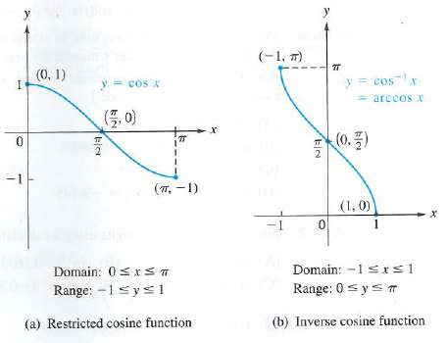
Inverse Cosine
y = cos⁻¹x or y = arccosx

Slide 9
y = cos⁻¹x means ‘the angle in the interval between 0 and pi whose cosine is x.’
Values of the inverse cosine are located in the upper half of the unit circle.

Slide 10
Find the exact values without a calculator!

Slide 11
Inverse Tangent
y = tan⁻¹x or y = arctanx
The vertical asymptotes become horizontal asymptotes when we reflect the graph over the line y = x.
The values are on the right side of the unit circle.

Slide 13
Find the exact values without a calculator!

Slide 14
Domain of Compositions of Trig Functions

Slide 15
Find the exact value, if it exists.

Slide 16
Find the exact value if it exists.

Slide 17
Find the exact value without a calculator.

Slide 18
Write as an algebraic expression in x.
sin(cos⁻¹x)
OR

Slide 19
Write as an algebraic expression in x.
tan(cos⁻¹x)
OR

Slide 20
Write as an algebraic expression in x.
cos(arcsinx)
OR

Slide 21
7.4 b Inverse Trig Functions
Sec, csc, cot

Slide 22
y = sin⁻¹x
y = csc⁻¹x
y = tan⁻¹x
y = cos⁻¹x
y = sec⁻¹x
y = cot⁻¹x

Slide 23
Find the exact values without a calculator!

Slide 24
Use your calculator to evaluate to 3 decimal places. (You must be in radians!!!)
csc⁻¹(1.82)
arcsec(-5.3042)
tan[cot⁻¹(-3.1087)]

Slide 25
Find the exact value, if it exists.

Slide 26
Find the exact value without a calculator.

Slide 27
7.5 Trig Equations
An equation that contains trig functions is called a trig equation.
To solve a trig equation we find ALL VALUES of the variable that make the equation true.

Slide 28
Ex 2sinx – 1 = 0

Slide 29
Ex tan²x - 3 = 0

Slide 30
Ex 2sin²x – 13sinx + 6 = 0

Slide 31
Ex 2cos²x – 7cosx + 3 = 0

Slide 32
Ex sinx = cosx

Slide 33
Ex 3cosx = 2sin²x

Slide 34
Ex 1 + sinx = 2cos²x

Slide 35
Ex 1 sin2x – cosx = 0

Slide 36
Ex 2 3tan³x – tanx = 0

Slide 37
Ex 3 secxtanx = 4sinx

Slide 38
Ex 4 cosx + 1 = sinx

Slide 39
Ex 5 2sin3x – 1 = 0 [0,2π]

Slide 40
Ex 5 $\sqrt{3}$tan$\frac{x}{2}$ – 1 = 0

